Slide 1
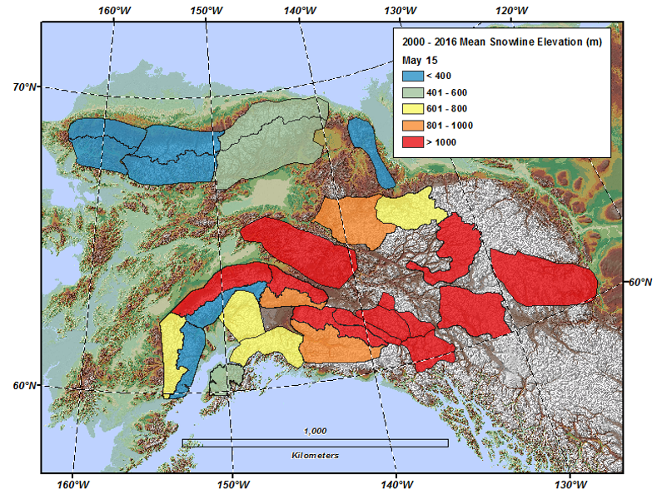
2000-2016 Alpine Spring Snowline Dynamics
D.Verbyla, T. Hegel, A. Nolin, M. van de Kerk, T. A. Kurkowski, L. R. Prugh
Background:
Spring snowline elevation is critical for many alpine herbivores because it affects forage quality and mobility.
Regional snowline products are lacking in arctic and boreal regions of North America.
Analysis:
We developed a regression technique using the daily MODSCAG snow fraction product to estimate last day of spring snow for each 500-m pixel within 28 mountain areas from 2000-2016.
We validated the approach with 53 Landsat based snowlines from May 5-May30.
Findings:
High spatial variability was related to regional climate patterns.
Temporal variability was related to May temperature and total winter precipitation.
Significance:
This regional remote sensing application accurately characterizes spring snowline dynamics, which may be useful for management of alpine wildlife such as Dall sheep.
Notes:
Citation: Verbyla D., Hegel, T., Nolin, A. W., van de Kerk, M., Kurkowski, T. A. and Prugh, L. R. 2017.
Remote Sensing of 2000–2016 Alpine Spring Snowline Elevation in Dall Sheep Mountain Ranges of Alaska and Western Canada.
Remote Sensing 2017, 9(11), 1157; doi:10.3390/rs9111157
NASA ABoVE grants NNX15AV86A (DV), NNX15AU21A (LRP) and NNX15AU13A (AWN): Assessing Alpine Ecosystem Vulnerability to Environmental Change Using Dall Sheep as an Iconic Indicator Species
Solicitation: Terrestrial Ecology (2014)

