Slide 1
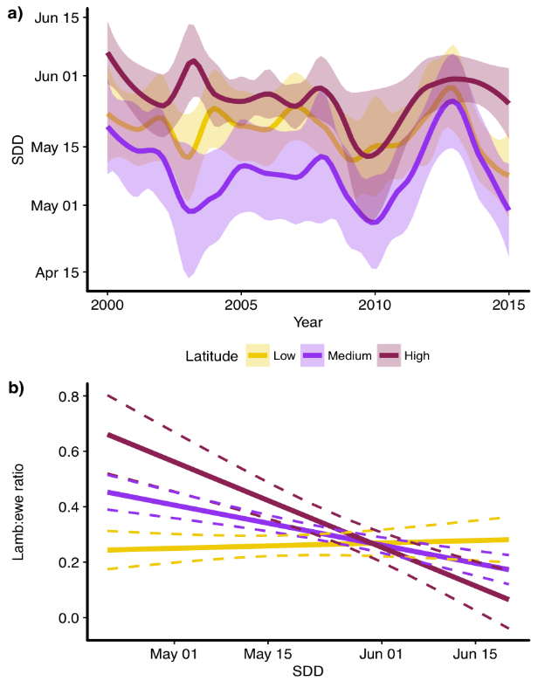
Range-wide variation in the effect of spring snow phenology on Dall sheep population dynamics
M. van de Kerk, D. Verbyla, A.W. Nolin, K.J. Sivy, L.R. Prugh
Environmental Research Letters 2018: https://doi.org/10.1088/1748-9326/aace64
Background:
Factors that limit species persistence are often assumed to be constant across species’ ranges but may vary spatially.
We examined the consistency of climate effects on population performance across the global range of Dall sheep.
Analysis:
We developed 3 snow cover products based on MODSCAG fractional snow cover: snow disappearance date (SDD), snow cover duration (SCD), and spring snowline elevation (SLE) from 2000-2015.
We evaluated the effects of temperature, precipitation, and snow cover on lamb-to-ewe ratios using data from 1,570 sheep surveys in 24 mountain units.
Findings:
Remotely-sensed snow cover strongly affected lambs, whereas temperature and precipitation had weaker effects.
Average snow cover did not decline in mountain units from 2000-2015, but interannual variability increased.
Late spring snow cover negatively affected lambs, and this effect amplified with latitude.
Above: Average snow disappearance date (SDD), with 24 mountain units outlined in purple. Right: Effect of SDD on lamb-to-ewe ratios at different latitudes.
Significance:
These results highlight the importance of spring snow phenology on the dynamics of iconic northern wildlife and suggest that northern Dall sheep populations may be more sensitive to changing snow conditions than their southern counterparts.
Notes:
Citation: van de Kerk, M., Verbyla, D., Nolin, A.W., Sivy, K.J. and Prugh, L. R. 2018. Range-wide variation in the effect of spring snow phenology on Dall sheep population dynamics. Environmental Research Letters: https://doi.org/10.1088/1748-9326/aace64
NASA ABoVE grants NNX15AU21A (LRP) NNX15AV86A (DV), and NNX15AU13A (AWN): Assessing Alpine Ecosystem Vulnerability to Environmental Change Using Dall Sheep as an Iconic Indicator Species
Solicitation: Terrestrial Ecology (2014)

