Slide 1
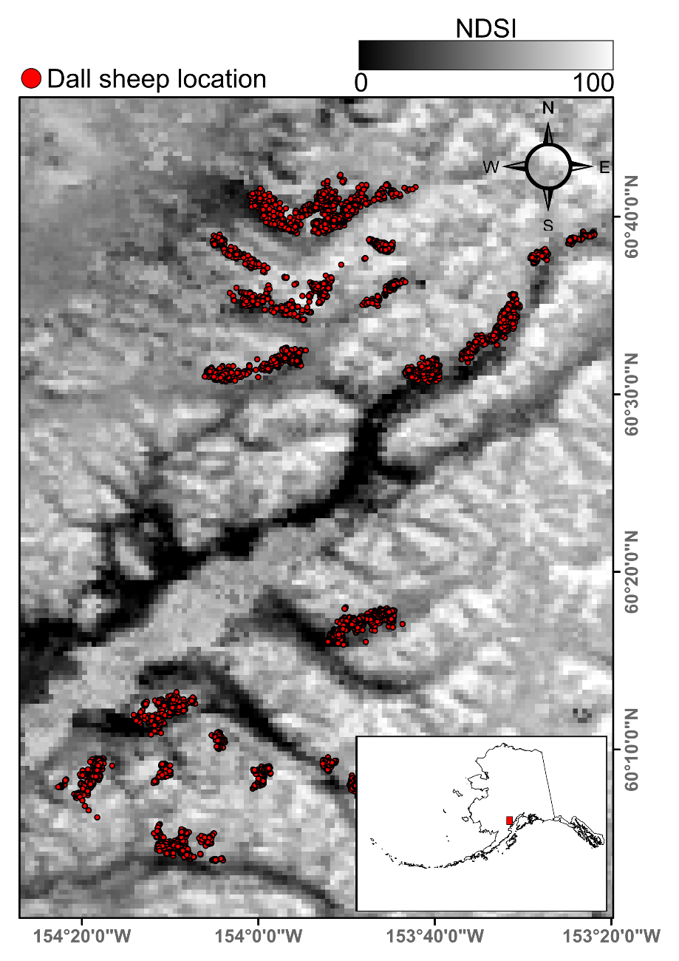
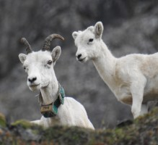
Navigating snowscapes: scale-dependent responses of mountain sheep to snowpack properties
P.J. Mahoney, G.E. Liston, S. LaPoint, E. Gurarie, B. Mangipane, A.G. Wells, T.J. Brinkman, J.U.H. Eitel, M. Hebblewhite, A.W. Nolin, N. Boelman, and L.R. Prugh (2018) Ecological Applications. DOI:10.1002/eap.1773
Background:
Winters and associated snowpack are limiting for many terrestrial animals due to resource scarcity and increased metabolic costs of travel. Understanding how animals move in response to dynamic snow conditions is needed to predict impacts of climate change on wildlife.
Analysis:
We used MODIS NDSI and modeled snow depth and density as predictors of animal movements at multiple spatial and temporal scales using locations from 30 GPS-collared Dall sheep in Lake Clark National Park and Preserve, Alaska from 2005-2008.
Results:
MODIS NDSI best predicted movements at weekly-to-monthly time scales, with sheep preferring areas of <56% fractional snow cover (Figure 1). Modeled snow depth and density were the best predictors at hourly-to-daily scales, with sheep selecting areas with snow density >290 kg/m³ and depth <50 cm.
Significance:
We demonstrate that remotely-sensed and modeled snow data products can greatly improve our understanding of animal movement at multiple scales, which will be critical to predicting wildlife responses to environmental change.
Figure 1: Dall sheep locations in relation to mean MODIS normalized snow index (NDSI) for February 2006-2008. (Photo: Luke Metherell / Alaska Department of Fish and Game)
Notes:
Author list: All co-authors are affiliated with NASA ABoVE projects with the exception of Buck Mangipane, a National Park Service data collaborator with Animals on the Move.
Study site: Lake Clark National Park and Preserve, Alaska
Funding: NASA ABoVE N. Boelman (NNX15AV92A), L. Prugh (NNX15AU20A and NNX15AU21A), M. Hebblewhite (NNX15AW71A), J. Eitel (NNX15AT86A), A. Nolin (NNX15AU13A), and T. Brinkman (NNX15AT72A).
Citation: Mahoney, P.J. , G.E. Liston, S. LaPoint, E. Gurarie, B. Mangipane, A.G. Wells, T.J. Brinkman, J.U.H. Eitel, M. Hebblewhite, A.W. Nolin, N. Boelman, and L.R. Prugh. (2018). Navigating snowscapes: scale-dependent responses of mountain sheep to snowpack properties. Ecological Applications. DOI: 10.1002/eap.1773
Archived dataset: Mahoney, P., G. Liston, B. Mangipane, and L.R. Prugh. 2018. ABoVE: Responses of Dall Sheep to Snowpack Properties, AK, 2005-2008. ORNL DAAC, Oak Ridge, Tennessee, USA. https://doi.org/10.3334/ORNLDAAC/1602

