Slide 1
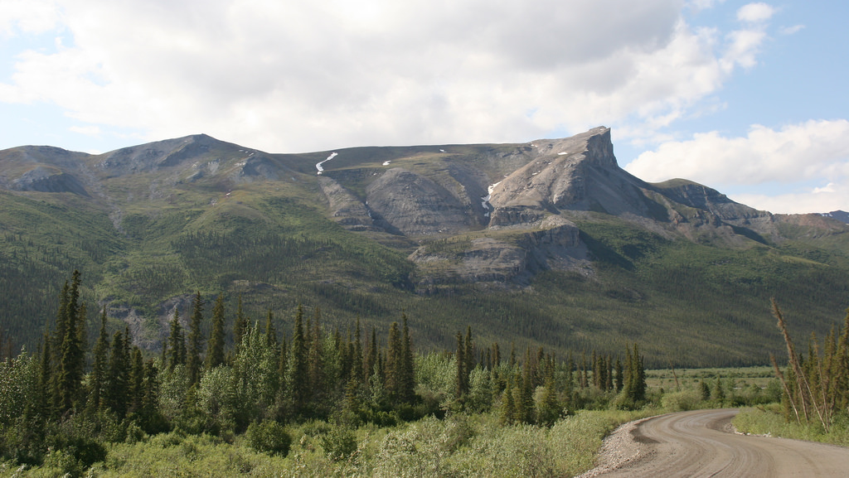
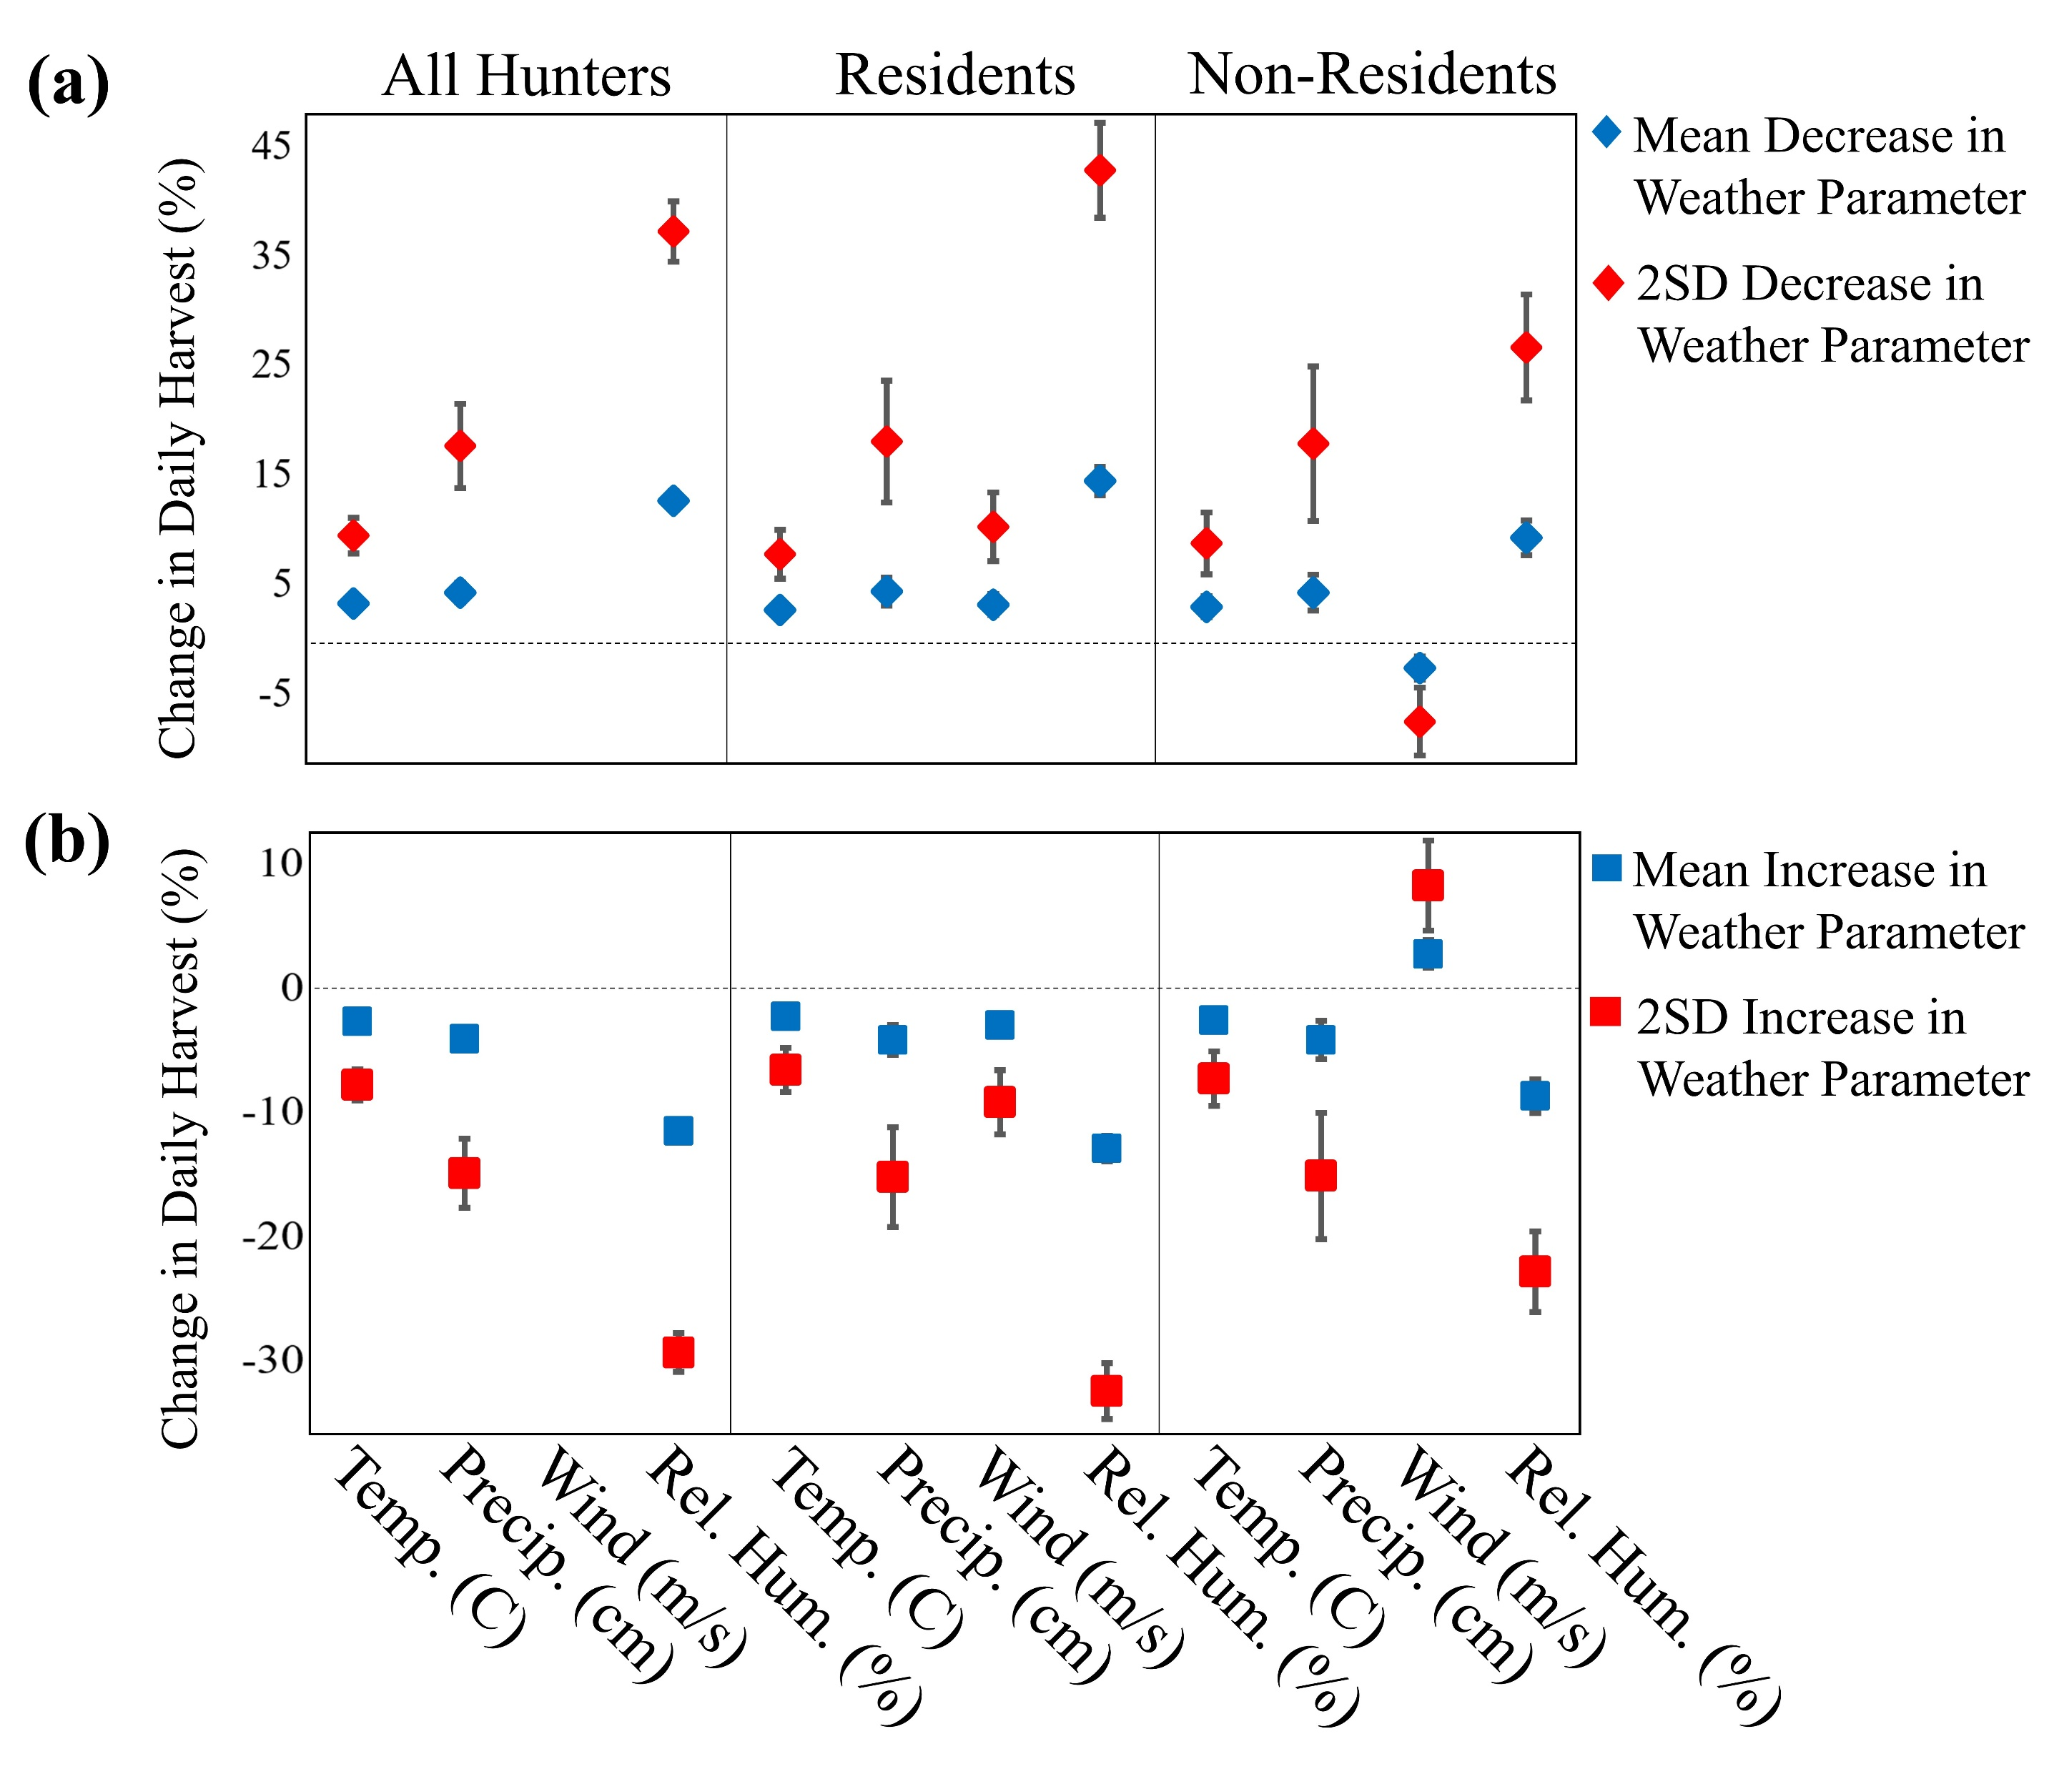
Association between weather and Dall’s sheep Ovis dalli dalli harvest success in Alaska
Scott Leorna, Todd Brinkman, Julie McIntyre, Brad Wendling, & Laura Prugh
Journal of Wildlife Biology 2020, doi:10.2981/wlb.00660
Background:
Despite decades of the wildlife studies implying that weather conditions influence hunter harvest opportunity, few studies have quantified the impact of weather on harvest success.
Incorporating weather variables into harvest management models may become increasingly important to wildlife managers as management adapts to a shifting climate.
We used a long-term dataset on Dall’s sheep harvest in Alaska as a case study to explore how changes in local daily weather have affected hunter harvest success.
Methods:
We complied daily Dall’s sheep harvest and weather data from five major mountain regions in Alaska between 1999-2015.
Weather variables included daily mean relative humidity, precipitation, air temperature and wind speed.
We used generalized linear mixed models to estimate relationships between daily harvest count and weather variables using three separate models; all hunters, resident hunters and non-resident hunters.
Key Findings:
We found that relative humidity had the largest effect on harvest, with average daily changes having two to three times as strong an effect on harvest as changes in precipitation, temperature or wind speed.
Relative humidity, wind speed and precipitation had slightly greater effects, while temperature had slightly less of an effect on resident harvest as compared to non-resident harvest.
Implications:
Quantifying weather-harvest associations may provide insight into effective strategies for adapting hunting regulations and meeting harvest goals.
Optimizing hunter harvest will continue to be an important tool for maintaining wildlife populations at densities that are socially and ecologically acceptable.
Incorporating weather variables into harvest models may prove useful for identifying the optimal timing of hunting seasons and for interpreting variability in harvest data.
This study represents one of the few that has quantified the effects of weather on ungulate harvest.
Figure: Estimates for all hunter, resident, and non-resident models for how a mean and two standard deviation (2SD) from the mean decrease (a) and increase (b) in each weather parameter affects percent change in daily Dall’s sheep harvest in Alaska, USA. Error bars represent the standard error calculated using the delta method.

