Slide 1
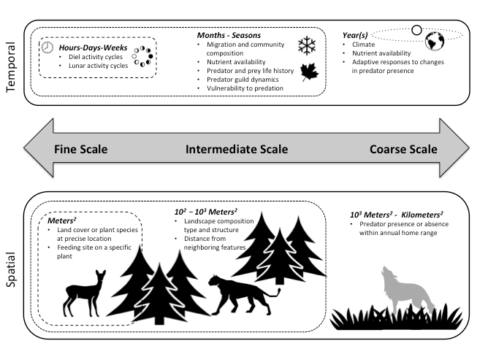
Designing studies of predation risk for improved inference in carnivore-ungulate systems
Prugh, LR , KJ Sivy, PJ Mahoney, TR Ganz, MA Ditmer, M van de Kerk, SL Gilbert, RA Montgomery (Feb 2019).
Biological Conservation DOI: https://doi.org/10.1016/j.biocon.2019.02.011
Background:
Understanding dynamics of carnivore-ungulate systems is needed to predict impacts of global change on ecosystem services provided by wildlife.
Substantial uncertainty remains in understanding predation risk despite decades of research in these systems, due primarily to lack of methodological standardization.
Analysis:
We provide an overview of major study design considerations and highlight how design choices affect the strength and scope of inference.
Results:
We propose a standardized framework to describe spatiotemporal scale(s) of predation risk studies (Fig. 1).
Emerging technologies, including UAVs and innovations in animal-borne remote sensors, will provide novel insights.
Significance:
The recommendations in this review will enhance the rigor and utility of predation risk research for the conservation and management of carnivore-ungulate systems, ultimately benefiting societies that depend on healthy wildlife populations.
Figure 1. Both temporal (top) and spatial (bottom) scales of predation risk may be considered along a continuum ranging
from fine scale to coarse scale, the extent and resolution of
which will vary depending on the study system and species.
Scale(s)of analysis should be described using a standardized framework to facilitate accurate interpretation and cross-study comparisons.
Notes:
This review paper is part of a Virtual Special Issue on Multi-species Risk Effects in Carnivore-Ungulate Systems in Biological Conservation. It was supported by NASA ABoVE grants NNX15AU21A and NNX15AU20A, which provided salary support to PI Prugh and postdocs M van de Kerk and PJ Mahoney.
Solicitation: Terrestrial Ecology (2014)
Citation: Prugh, L. R., K. J. Sivy, P. J. Mahoney, T. R. Ganz, M. A. Ditmer, M. van de Kerk, S. L. Gilbert, and R. A. Montgomery. 2019. Designing studies of predation risk for improved inference in carnivore-ungulate systems. Biological Conservation 232:194-207. https://doi.org/10.1016/j.biocon.2019.02.011.

