Slide 1
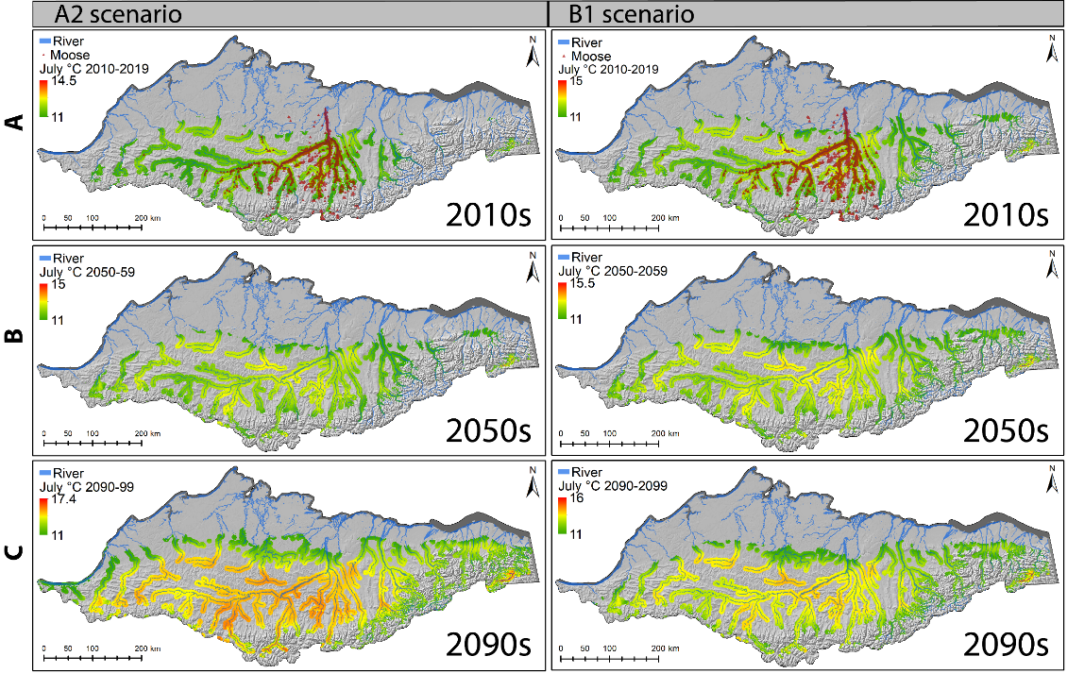
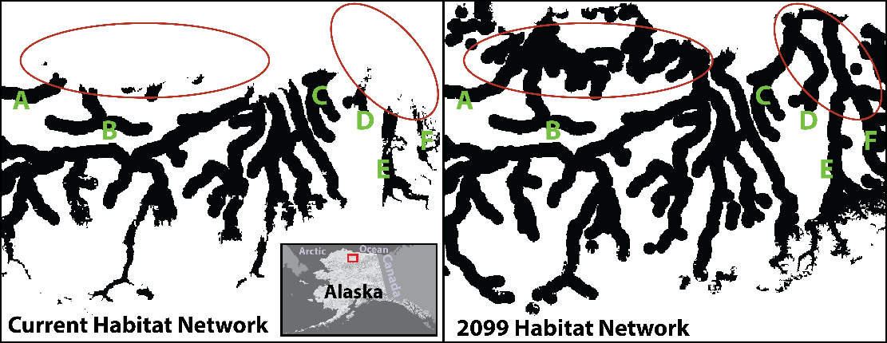
Enhanced shrub growth in the Arctic increases habitat connectivity for browsing herbivores
Zhou, Tape, Prugh, Kofinas, Carroll, & Kielland (2020), Global Change Biology http://dx.doi.org/10.1111/gcb.15104
Background
The expansion of shrubs across the arctic-boreal region may be facilitating range shifts, such as expansion of moose populations into the Arctic.
How shrub expansion will influence range shifts of wildlife via changes in habitat connectivity is not well understood.
Methods
We modeled moose habitat suitability using gridded climate data, a 19-year moose location dataset, a 568 km transect of shrub sampling, and forecasted warming scenarios with regional downscaling.
We predicted current and future shrub habitats for moose in northern Alaska.
Findings
Tall-shrub habitat for moose will likely more than double on the North Slope by 2099 (Fig 1).
Spatial cohesion of the habitat network will likely increase (Fig 2).
Fig 1. Predicted increases in shrub habitat for moose under IPCC A2 and B1 warming scenarios.
Significance
Climate change may enhance range expansion of moose by diminishing fragmentation effects
Synergistic effect of patch network dynamics and regional warming may drive species range shifts in the Arctic
Fig 2. Structural connectedness of shrub habitat networks increased within the landscape under the A2 scenario.
Notes:
Citation: Zhou, Jiake; Tape, Ken; Prugh, Laura; Kofinas, Gary; Carroll, Geoff; Kielland, Knut. 2020. Expansion of shrubs in the Arctic enhances habitat connectivity for browsing herbivores. Global Change Biology http://dx.doi.org/10.1111/gcb.15104.
NASA ABoVE grant NNX15AU21A (LRP): Assessing Alpine Ecosystem Vulnerability to Environmental Change Using Dall Sheep as an Iconic Indicator Species
Solicitation: Terrestrial Ecology (2014)

