Slide 1
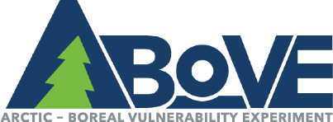
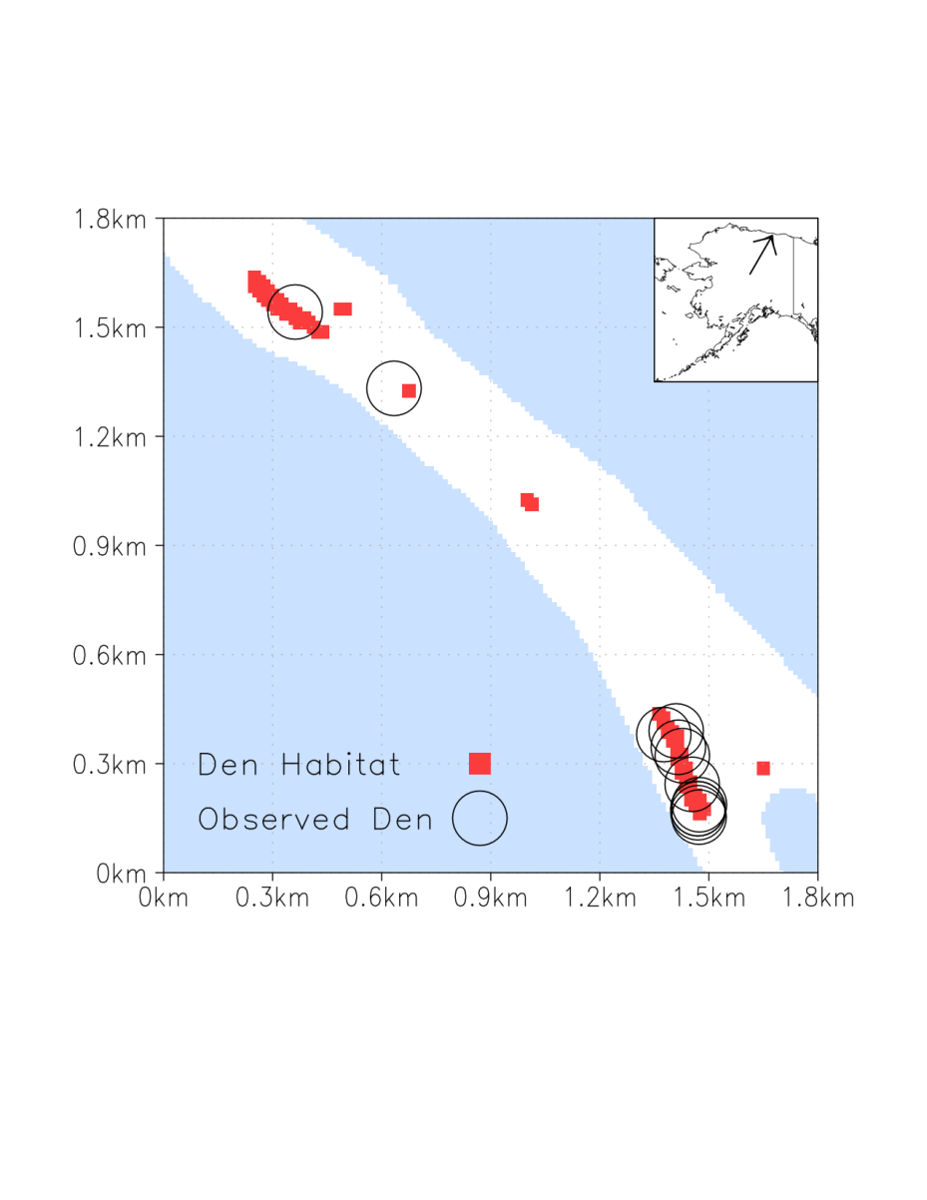
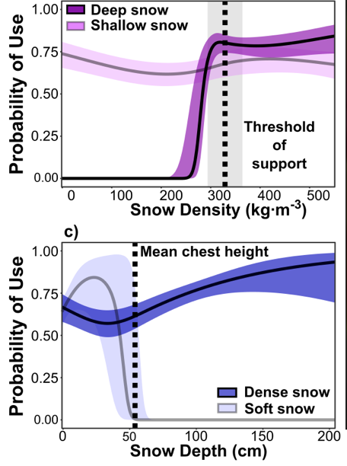
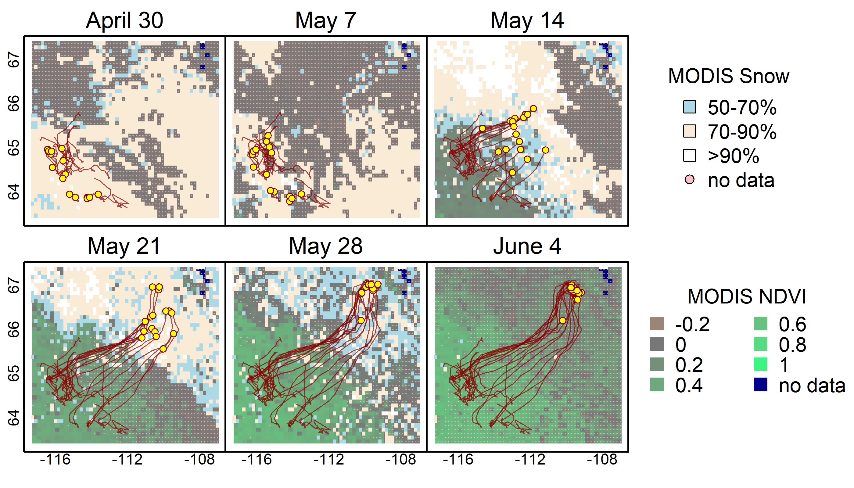
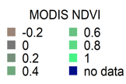
Integrating snow science and wildlife ecology
in Arctic-boreal North America
NTB Boelman, G Liston, E Eliezer, AJH Meddens, P Mahoney, P Kirchner, G Bohrer, T Brinkman, C Cosgrove,
JUH Eitel, M Hebblewhite, J Kimball, S LaPoint, A Nolin, S Højlund Pedersen, L Prugh, A Reinking, LA Vierling
Environmental Research Letters, 2019, https://dx.doi.org/10.1088/1748-9326/aaeec1
Background. Arctic warming has changed the spatial extent, distribution, seasonal timing and duration of snow cover, while also altering the physical characteristics of the snowpack in ways that likely impact wildlife in myriad ways. Objective: To demonstrate the urgent need for, and suggest an approach for developing, an improved suite of spatial snow products to understand how dynamics in Arctic-boreal snowscape properties impact wildlife.
Analysis. We present 3 case studies that employ satellite observations, snowpack evolution models, and data-model fusion approaches to show the need for new, temporally evolving, and spatially distributed snow products.
Results. Fig. 1 Polar bear den habitat locations change yearly depending on wind speed and direction, and snowfall. 97% of observed maternal den locations were correctly identified from the potential locations of snowdrifts simulated by SnowDens-3D.
Fig. 2 At fine movement scales, Dall sheep generally selected for low density, shallow snow (top), but for higher snow density at or above the mean threshold of body support when traveling through deep snow above mean chest height (bottom).
Fig. 3 Investigation of 15 spring migrations (2000 - 2014) of the Bathurst caribou herd reveals that caribou do not migrate consistently with
respect to MODIS-derived
snowmelt timing in their winter or calving ranges. In fact, as shown in the figure, the caribou migrate over continuous snow cover, suggesting that snow quality may be important.
Significance. The coordinated in situ measurements, airborne and satellite remote sensing data, and modeling tools being collected and developed as part of NASA’s ABoVE and SnowEx campaigns provide a data rich environment for developing a data-model fusion approach to generate fit-for-purpose snow spatial products for Arctic-boreal wildlife studies and beyond.

